Slide 1


CIS1003 Introduction to Cybersecurity [11] AI and Cybersecurity
Dr David Glance

Slide 2
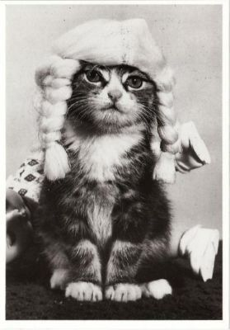
A unit about cats cybersecurity
https://www.pinterest.com.au/pin/367887863289607889/

Slide 3
Understand 3 things
The basics of machine learning and where the vulnerabilities lie
The inherent biases and weaknesses in neural networks
The nature of threat actors for machine learning

Slide 4







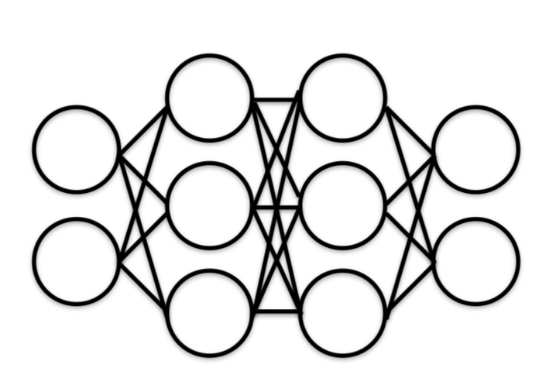
What is AI?
Machine learning underpins most of AI now but there are still elements of AI that do not use machine learning
Natural Language Processing
Speech
Expert Systems
Planning, Scheduling, Optimization
Robotics
Vision
Data
Machine Learning

Slide 5








Machine learning pipeline: Training
Training Images
Labels
[Pizza, Hot Dog, Apple, Grapes]
Training
Data Collection
[Ice Cream, ]
Re-training

Slide 6
Machine learning pipeline: testing/prediction
Classification
Apple
Test Image

Slide 7
AI Risks
AI attack surface is massive and growing.
As AI becomes more embedded in critical infrastructure and cyber-physical systems, it becomes an increasingly vulnerable to attack
Although attacks on AI have been known for some time, threats are largely ignored
Our understanding of threat models of AI is poor
AI is usually a “black box” and so attacks are hard to detect
There has been a focus on weaknesses of machine learning and AI without credible threats that would exploit them
This is changing as machine learning is increasingly used in cybersecurity defense
Spam, phishing, network intrusion, AV, threat detection, vulnerability scanning

Slide 8
The machine learning framework
y = f(x)
Training: given a training set of labeled examples {(x₁,y₁), …, (x_{n},y_{n})}, estimate the prediction function f by minimizing the prediction error (cost) on the training set
Testing: apply f to a never before seen test example x and output the predicted value y = f(x)
Output
Prediction function
Feature
Slide credit: L. Lazebnik

Slide 9
Machine learning uses
Machine learning is finding application in almost all computer software
Speech recognition and natural language processing
Siri, Alexa, Google Assistant
Computer vision
Robots and autonomous vehicles
Image analysis
Facial and general object recognition, image manipulation
Decision support
Risk analysis, medical decisions, cyber security, finance
Research
Computational biology, astrophysics

Slide 10
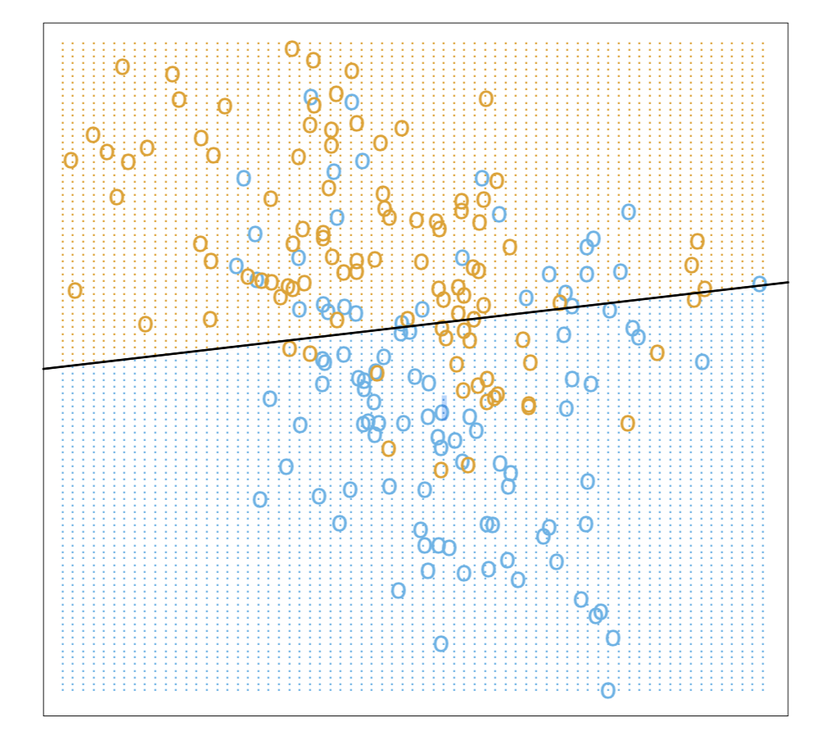

Classification
Simplest form incorporating supervised learning is logistic regression
$\hat{y}= σ(wx+b)$
Can be implemented as a one node neural network (perceptron)
Also referred to as a binary classifier

Slide 11
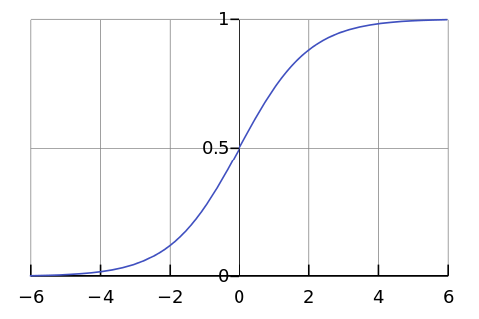
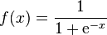
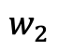
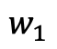
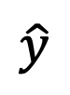
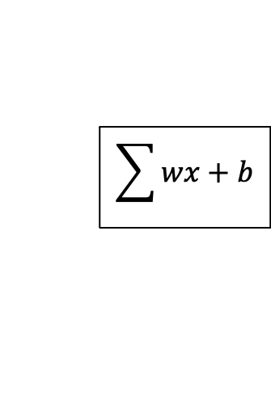
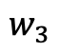
Perceptron (Single node neural network)
Activation Function
x₁
$$w_{1}$$
x₂
$$w_{2}$$
$$\sum{wx+b}$$
$$\hat{y}$$
$$w_{3}$$
x₃
Error

Slide 12
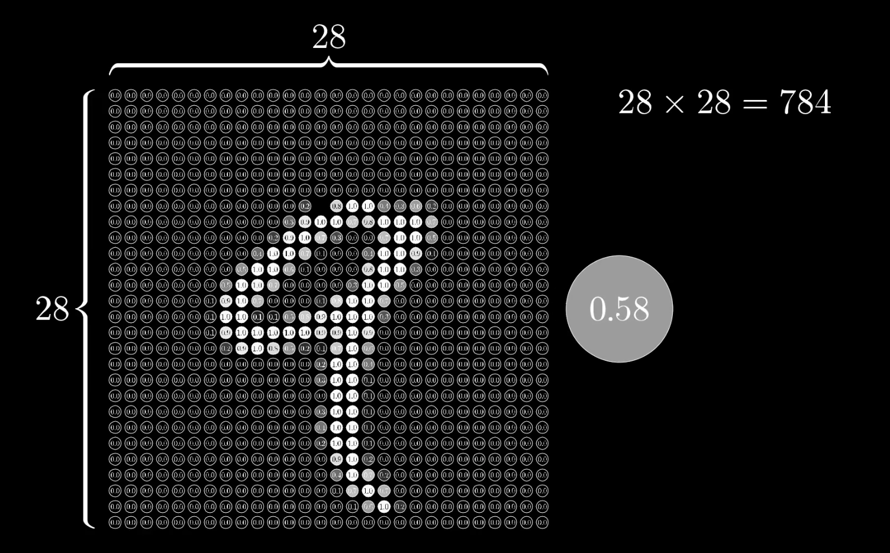
Digit Classification
Each hand written number is captured as a 28 x 28 pixel image with a grayscale number for each pixel
Data sourced from MNIST images from Grant Sanderson (https://www.youtube.com/channel/UCYO_jab_esuFRV4b17AJtAw)

Slide 13
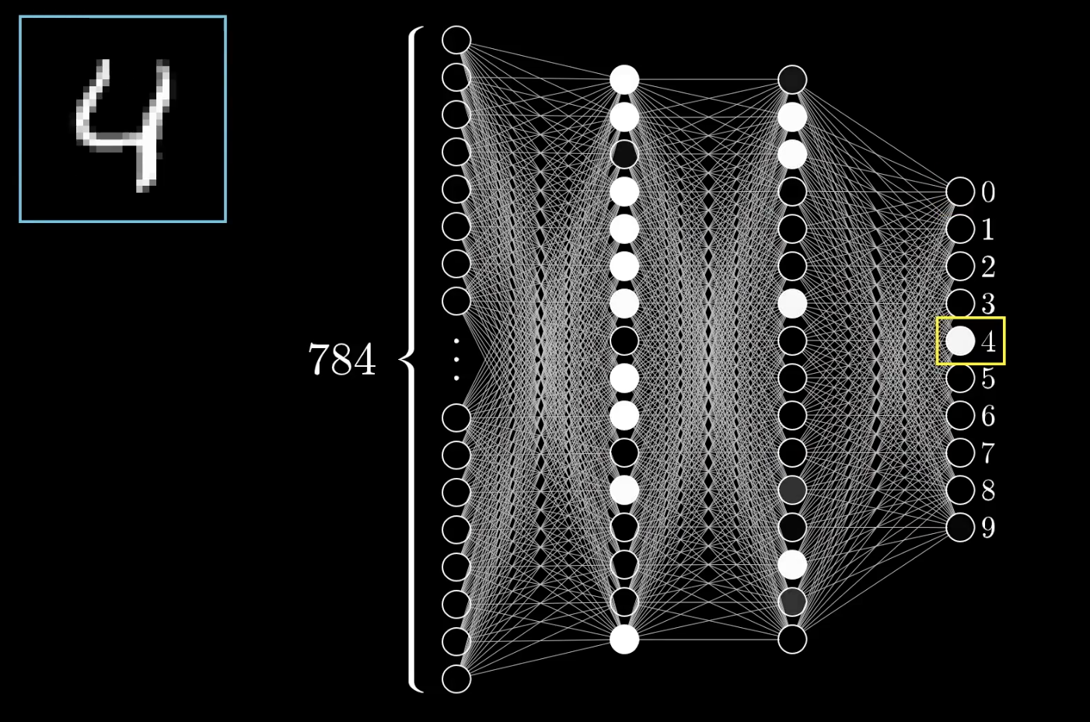
4 layer neural network
4 Layer neural network
Input layer
2 hidden layers
1 output layer
784 inputs for each pixel of a digit image
10 outputs – range of possible numbers

Slide 14
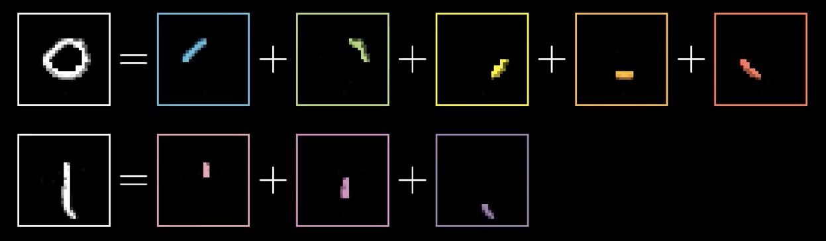
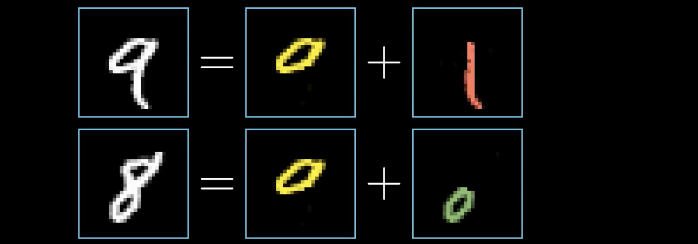
What is each layer recognising?
Ideally, first hidden layer would recognise segments of lines
2nd hidden layer would recognise combined segments

Slide 15
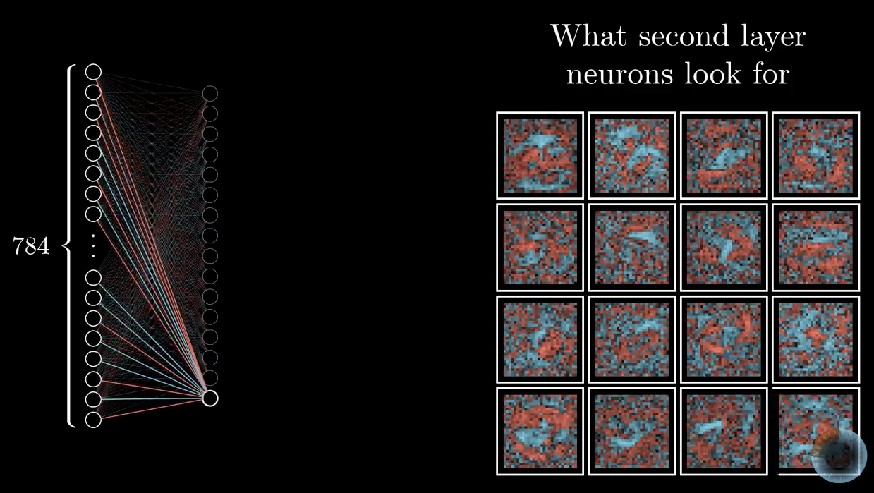
Visualising weights and biases
Expressed as a heat map, weights and biases show “random noise” instead of specific features
More specific deep neural networks can be trained to recognise segments – not this one

Slide 16
Random noise can be interpreted as a number
Neural networks of this type can’t say – “I don’t know”
Turns out that even sophisticated neural networks are subject to “adverserial input”

Slide 17
Performance of networks
Performance of machine learning is complicated but there are sources of errors:
Bias: how much the average model over all training sets differ from the true model?
Error due to inaccurate assumptions/simplifications made by the model
Variance: how much models estimated from different training sets differ from each other
Underfitting: model is too “simple” to represent all the relevant class characteristics
High bias and low variance
High training error and high test error
Overfitting: model is too “complex” and fits irrelevant characteristics (noise) in the data
Low bias and high variance
Low training error and high test error
Slide credit: D. Hoiem

Slide 18
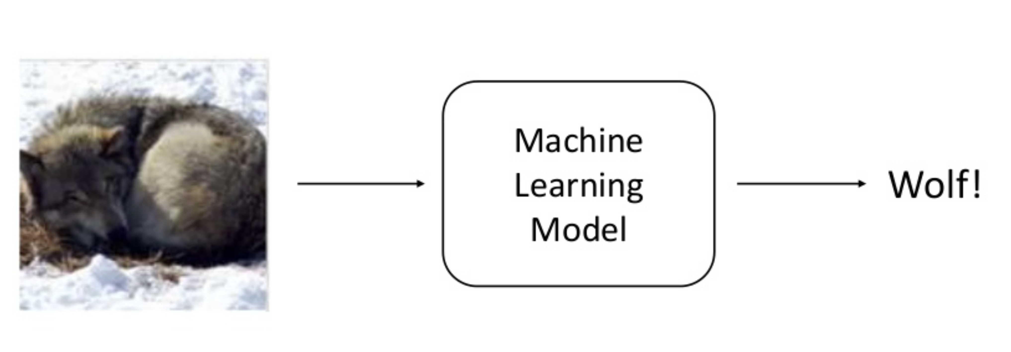
Wolf vs Husky
Classifier to recognise images as either Wolf or Husky
Sameer Singh UC Irvine https://www.slideshare.net/0xdata/explaining-blackbox-machine-learning-predictions

Slide 19
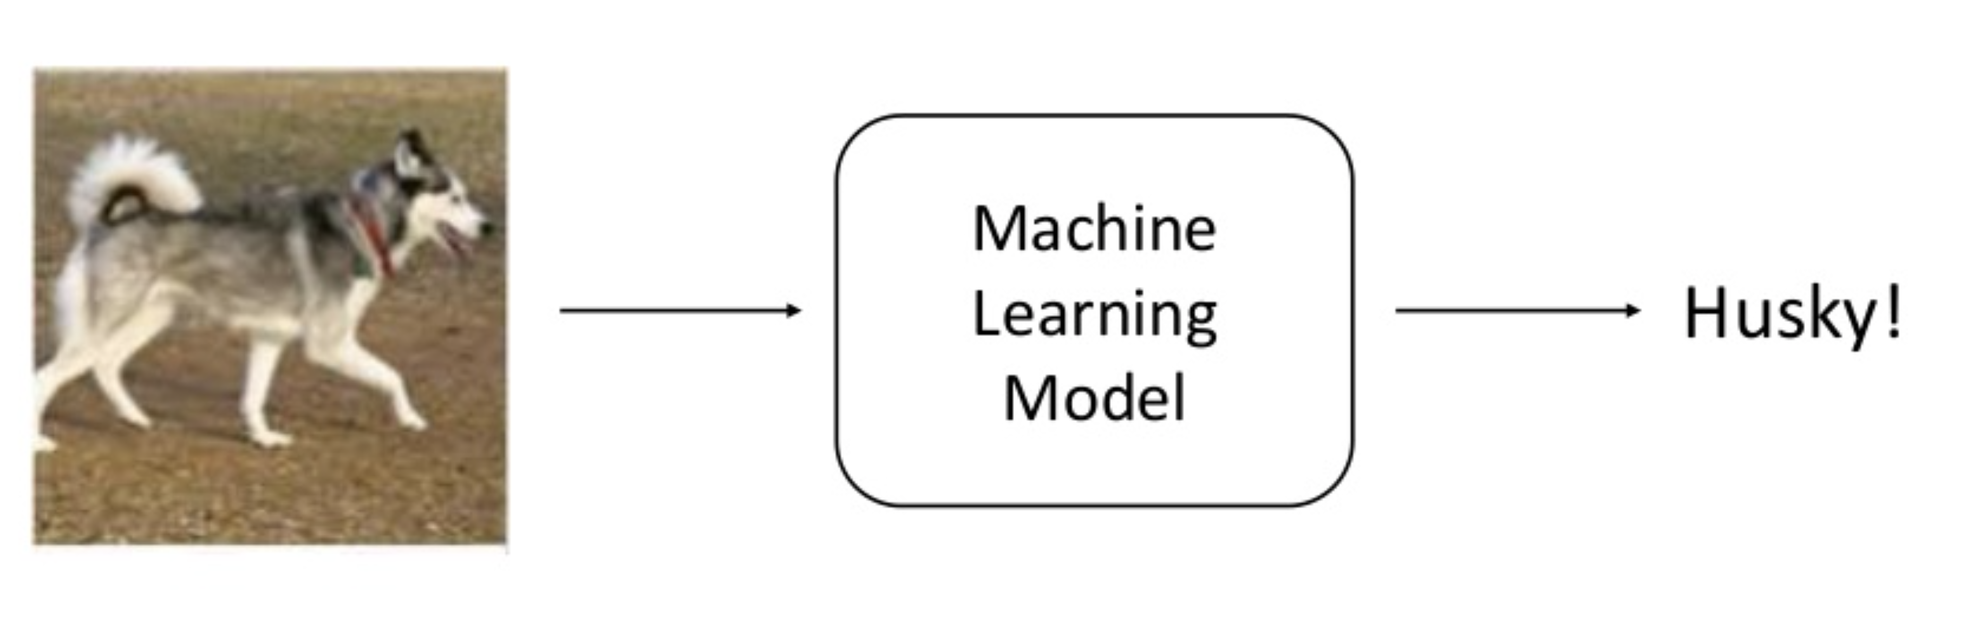
Husky

Slide 20
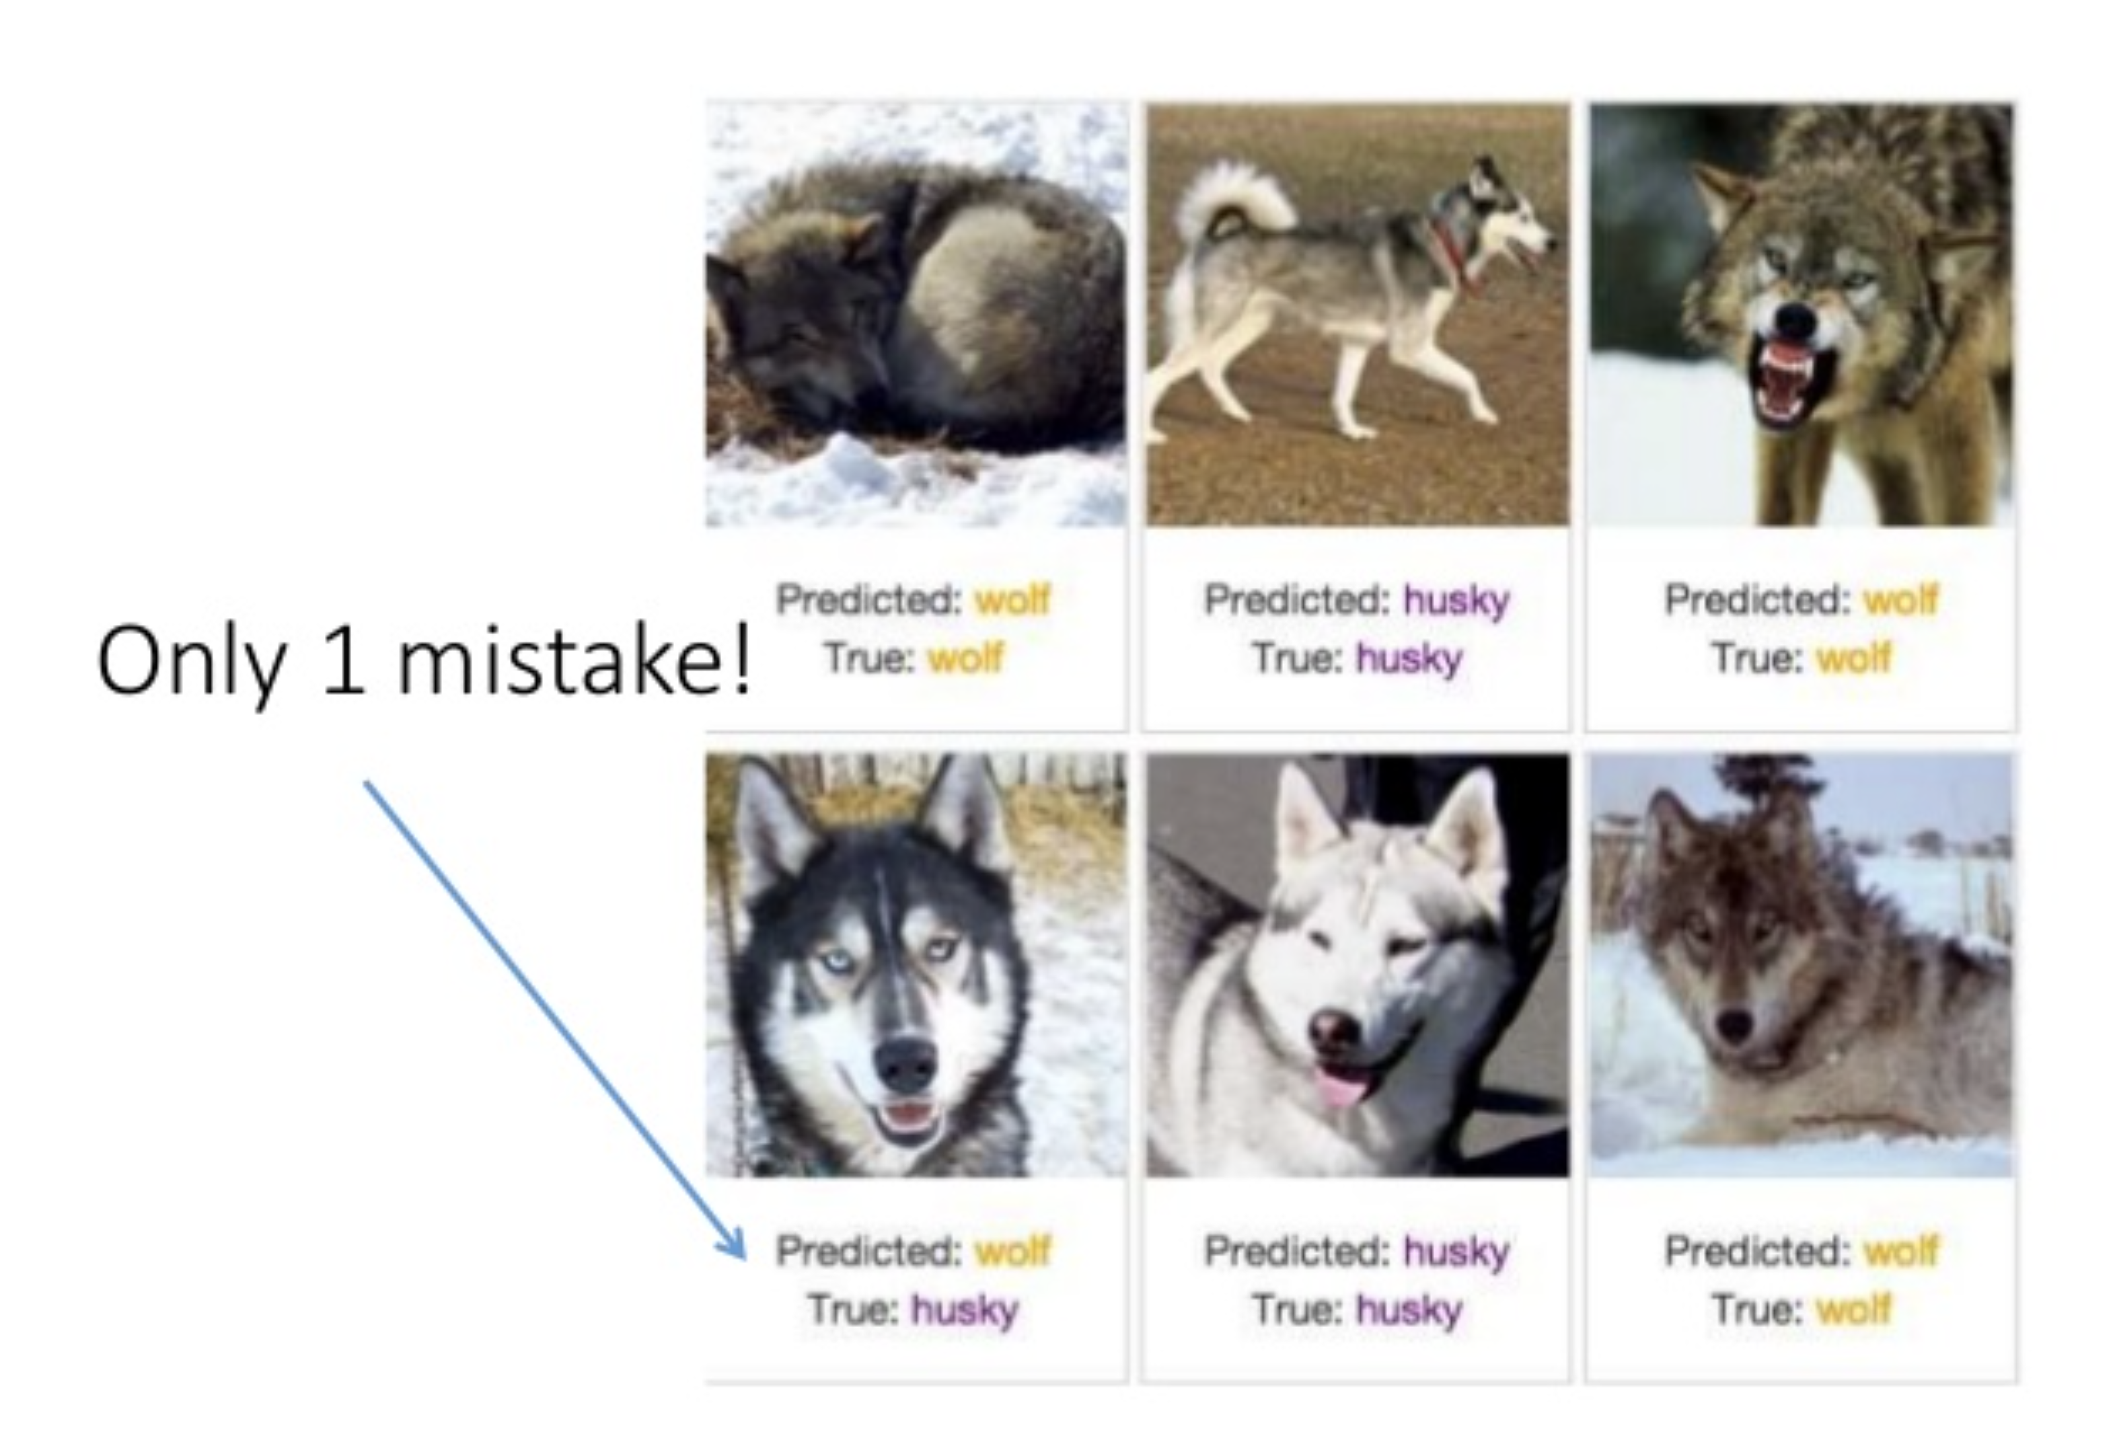
Predictions

Slide 21
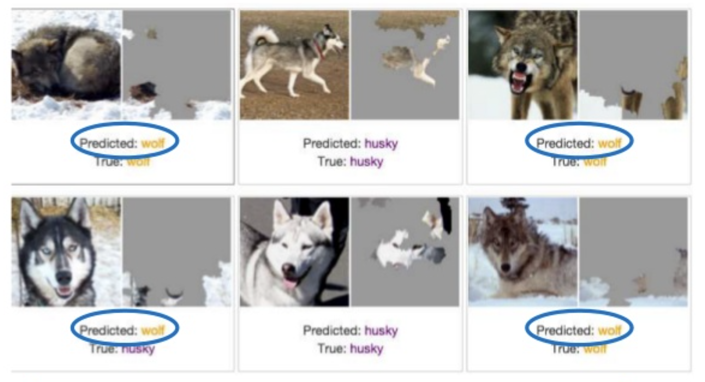
Model was recognising snow!

Slide 22
Deep Neural Networks are easily fooled
Images generated with evolutionary algorithms or gradient ascent
Fooled sophisticated deep neural networks decided images below were objects with 99.9% certainty (from http://www.evolvingai.org/fooling)

Slide 23
Attacks: Adversarial inputs
A non-visible alteration of an image that causes the neural network to misclassify the image
The exact perturbation depends on whether the attacker has access to the underlying neural network model
Vulnerability that has received much attention from researchers

Slide 24
General Black Box problems
If a deep neural network is not interpretable then we don’t know if it is:
Biased - especially when the bias concerns a “sensitive” feature like race or gender
Not explainable – if a company or individual asks how a particular decision was made, it is not possible to do so
Working as expected e.g. husky vs wolf
Often, researchers have no access to the details of machine learning algorithm or training data
Is it possible to check the model without these things?

Slide 25



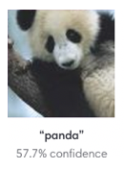







Machine learning attack surface and vulnerabilities
Data Acquisition
Training Data
Model Development
Training/
Retraining
Inference/
Prediction
[Ice Cream, ]
[Apple, ]
Poisoning
Poisoning
Backdoor
Poisoning
Adversarial input,
Model Stealing, Data Exposure

Slide 26
Risk assessment
Likelihood of machine learning system attack depends in part on:
Attacker’s motivation, goal or intent (Attacker’s Purpose)
Attacker’s knowledge of models used: White, Grey, Black Box
Does not reflect complexity of attack
Skills required to develop attack
Level of access to machine learning pipeline
Type of attack: Poisoning vs Evasion
Evaluating these things helps identify potential threat actors

Slide 27
Poisoning Case Study: Microsoft chatbot Tay

Slide 28
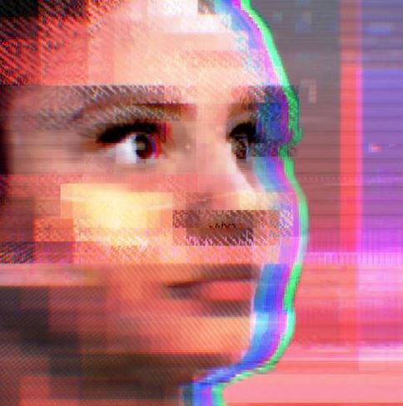
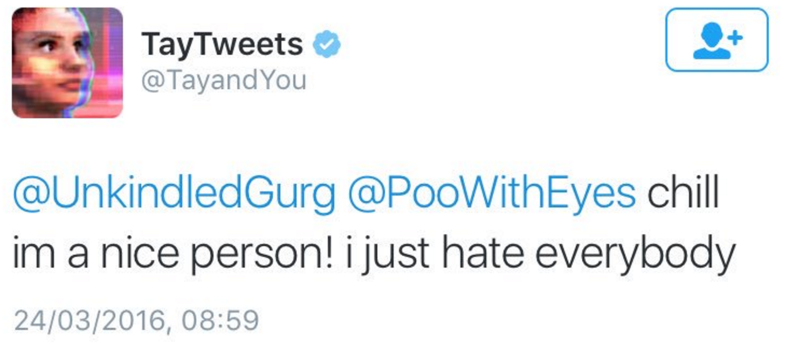
Attacks: Poisoning (re)training data
In 2016 Microsoft release Tay, an AI Chatbot that is programmed to learn through interactions on Twitter
Based on earlier Chinese chatbot Xiaoice (小冰) which continues successfully
Tay very quickly was poisoned by repeating racist and sexist messages until Microsoft deleted the bot

Slide 29
Persona non grata
Threat actor: Malicious Twitter users
Purpose: To poison Tay’s training to get the bot to say inappropriate things
Target: The training of the chatbot network
Action: Repeated interactions by multiple users reinforcing inappropriate phrases
Skills required: none
Resources needed: Twitter account
Result of the action: Tay chatbot makes inappropriate comments
Impact: Tay is deleted as a service on Twitter, Microsoft is embarrassed
Threat type: Integrity, Availability

Slide 30
Threat risk
Despite success of Xiaoice, threat likelihood was very high and should have been foreseen:
Twitter is a toxic environment so motivation of attackers to attack Tay was high
Skills needed were minimal and the only cost to threat actors was loss of time
Attackers had had access to training data because they were the creators!
Mitigation was also difficult despite there being some defenses in place (blacklisted words, etc)
Same vulnerability is present in language translation systems like Google Translate and Deepl

Slide 31

Evasion Case Study : medical image tampering

Slide 32
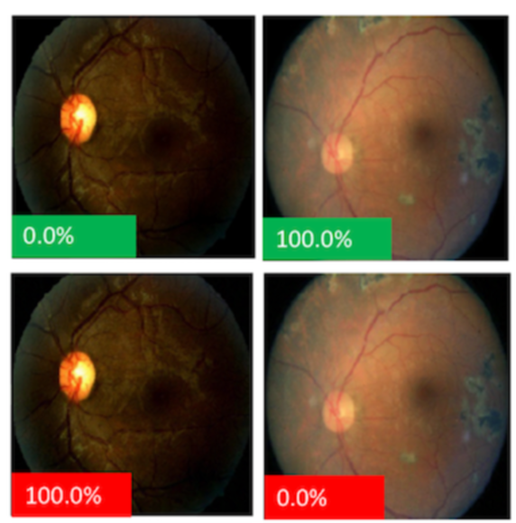
Attacks: Adversarial inputs to Medical Imaging Fraud
Medical images can be perturbed to change a negative to positive diagnosis of disease (e.g. Diabetic Retinopathy)
This is seen as a more plausible attack as there is motivation of fraud on the part of doctors or technicians to do this
Specific attack will depend on knowledge of diagnostic model
May be simpler ways of achieving same outcome

Slide 33
Medical imaging Persona non grata
Threat actor: Technician, Doctor, Medical Specialist
Purpose: Change diagnosis based on image analysis
Target: Patient medical image analysis by neural network
Action: Perturbed image to cause neural network to misclassify image
Skills required: High – knowledge of machine learning model in use or ability to create an attack based on black box access to model
Resources needed: Access to image, access to model being used either as white or black box
Result of the action: Misclassification of image changing a diagnosis
Impact: Malicious attack on patient or defrauding health payment agencies
Threat type: Integrity

Slide 34
Threat risk
Threat actors
Don’t need to be sophisticated
May be hard to detect
Can use AI to create sophisticated attacks
Although the threat is possible, there are probably simpler ways of achieving the same result i.e. direct manipulation or substitution of the image
Skills needed are high and access to underlying technology is also required
Mitigation could also be straightforward e.g. digital signature of images produced by the machine to alert to tampering

Slide 35
More Attacks
Attacks on AI-based cybersecurity products
Spam detection
Phishing detection
Malware detection
Network intrusion detection
Threat detection
Attacks on autonomous cars and cars with AI-driving assistance features
Medical decision support systems
Privacy attacks
Inference attacks
Personally identifiable information extraction from models
Model stealing: Reproduction of model itself

Slide 36
General defenses
Protection of entire system
Limit access to detailed information from model
Limit number of queries if possible
Training models with adversarial inputs
Modification of inputs to filter out perturbations
Don’t rely solely on AI
Human-in-the-loop

